Slide 1


Case Study Template
1

Slide 2

Python-Project 1
Matteucci Cyril
Date: June 25, 2021

Slide 3
Agenda
Introduction , Problem
Methodology
Results.
Proposed Solutions
Appendix - Additional Resources
Team Members

Slide 4
Introduction
Who i am?
I’am Matteucci Cyril.
What is the problem?
Haiti Analytics is facing a problem where they need to organize a training but they have difficulty in selecting
which 3 communes would be best for their training.

Slide 5
Systems Analysis
Who is the client?
The client is AyitiAnalytics.
Our client is Ayiti Analitycs, a Haitian campaign that wants to help young people with technology and provides advice to businesses. they are facing certain problems and they have hired us to solve them

Slide 6
Stakeholders
Ayiti Analytics
Haiti analytics wants to achieve training in other communes but it is difficult to know which communes are the best.
The applicants
the applicants realize that the number of people taken is too small

Slide 7
Methodology
1) receive the data
2) use tools that allow us to clean the data
3) analyze the data
4) propose solutions

Slide 8
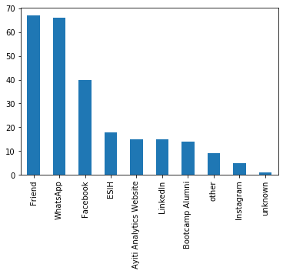
What are the most effective communication channels (Alumni, Facebook, WhatsApp, Friend ...) that will allow a student to be susceptible to selection?
response:
this chart shows 3 channels with more rates, these channels are: friend, what'sapp, Facebook

Slide 9
t
What is the average number of university students who should participate in this program?
The average number of university students who should participate in this program is 19.560000000000002 equal to 20

Slide 10
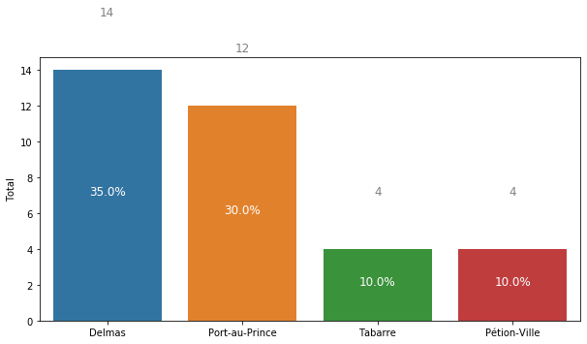
If we were to do all the bootcamp online, who would be the best communes and how many applications would we need to select 30 student and what percentage of students would have a laptop, an internet connection, both at the same time
if we were to realize this program on the internet the best communes are Delmas, Port-au-Prince ,Tabarre and Petion-ville

Slide 11
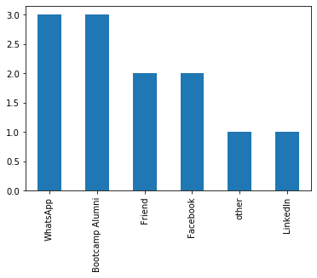
What are the most effective communication channels (Alumni, Facebook, WhatsApp, Friend ...) that will allow a women to be susceptible to selection?
The most effective ways for people to communicate (alumni, Facebook, WhatsApp, friends ...) that will allow a woman to be more easily selected are: Whatsapp, Bootcamp Alumni, Friends

Slide 12
The quantity of applications that we must be made to select 25% women for each on average?
Total quantity of future applicants selected : 90
The quantity of future women selected : 23
the selected women ratio of now : 20.0 %
Future women application number needed: 265
Number of future applications needed if we want to select 25% women for each cohorts on average , with 3 cohorts of 30 selected students : 1410

Slide 13
How many weeks should we extend the application process to select 60 students per commune?
Total future applicants : 2250.0 applicants
Total future selected : 180 applicants
Total future applicants : 2250.0 applicants
If we want to have 60 select students per commune , and if we have the same average application by week ,the extend delay found will be : 40.0 weeks

Slide 14
SWOT
Strength | weakness
They called specialists to help them with their problems. | AA don't advertise so that more people know about them.
they have specialist data in all sectors | they do not have an annex in each commune

Slide 15
Opportunities | Treats
the possibility of better organizing the other cohorts | The pandemic Covid 19
also find ways to make their choices easier for other cohorts | political instability
 | Insecurity

Slide 16
Solutions
Conduct a survey of each commune to find out which commune will be more likely for the bootcamp before even launching registrations.
create marketing that will interest women integrated into the world of technology so they can always have 25% women on the list

Slide 17

Appendix
What resources can the audience use to further understand the message and story being presented?
For further informations, please visit: https://github.com/engy06/Repository06.git

Slide 18
Prepared by :Matteucci Cyril

